Slide 1

Intermediate PyTorch
©CounterFactual.AI LLC. All rights reserved. Do not distribute.

Slide 2
A tensor is an N-dimensional data structure (data container)
Rank 0 Tensor
scalar
Rank 1 Tensor
array, list, vector
Rank 2 Tensor
matrix
Rank 3 Tensor
Tensor dimension is not tensor shape !

Slide 3
Reshape a B&W image tensor as a 784 element rank 1 tensor
2
28 x 28 pixels
 |  |  |  |  | ...
...
255 | 100 | 150 | 0 | 200 | ...
...
784 element tensor array
Notes:
input: 28x28 image
Flattened into a batchsize x 784 array

Slide 4
A tensor can be implemented as arrays of arrays of arrays of ...
…
…
…
…
…
…
…
…
…
…
…
…
Rank 4 Tensor
Rank 5 Tensor
Rank … Tensor
Rank 4 Tensor for YouTube videos?

Slide 5
Demo: PyTorch Tensor Numerics

Slide 6
Exercise: PyTorch Tensor Numerics

Slide 7
Agenda
 | torch.autograd

Slide 8

8

Slide 9
PyTorch Autograd (autodiff) In a Nutshell

Slide 10
PyTorch tensor attributes support gradient calculations
Tensor value(s), such that x == x.data
x = pt.tensor(...)
x.data
x.is_leaf = True
x.requires_grad = False
x.grad = None
x.grad_fn = None
True unless created from a tensor with requires_grad=True
False when is_leaf = True
Gradient value if exists
Function that knows how to perform backward()
Notes:
All Tensors that have requires_grad which is False will be leaf Tensors by convention.
For Tensors that have requires_grad which is True, they will be leaf Tensors if they were created by the user. This means that they are not the result of an operation and so grad_fn is None.
Only leaf Tensors will have their grad populated during a call to backward(). To get grad populated for non-leaf Tensors, you can use retain_grad().

Slide 11
PyTorch disables tensor autodiff (autograd) by default

Slide 12
GPU Support for PyTorch tensors and tensor operations
Central Processing Unit (CPU)
Control
ALU
ALU
Graphical Processing Unit (CPU)
ALU
ALU
Cache
DRAM

Slide 13
Demo: PyTorch Autograd & GPU

Slide 14
Exercise: PyTorch Autograd & GPU

Slide 15
Agenda
 | Deep(er) Neural Networks ReLU nn.Sequential

Slide 16
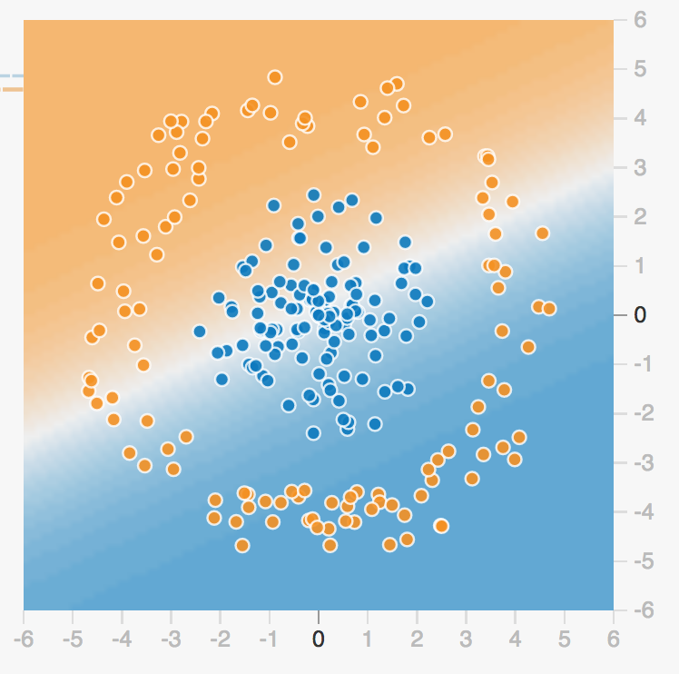
Can you use a single line to separate these? What do you have to do?
goo.gl/nfuA2r
16

Slide 17
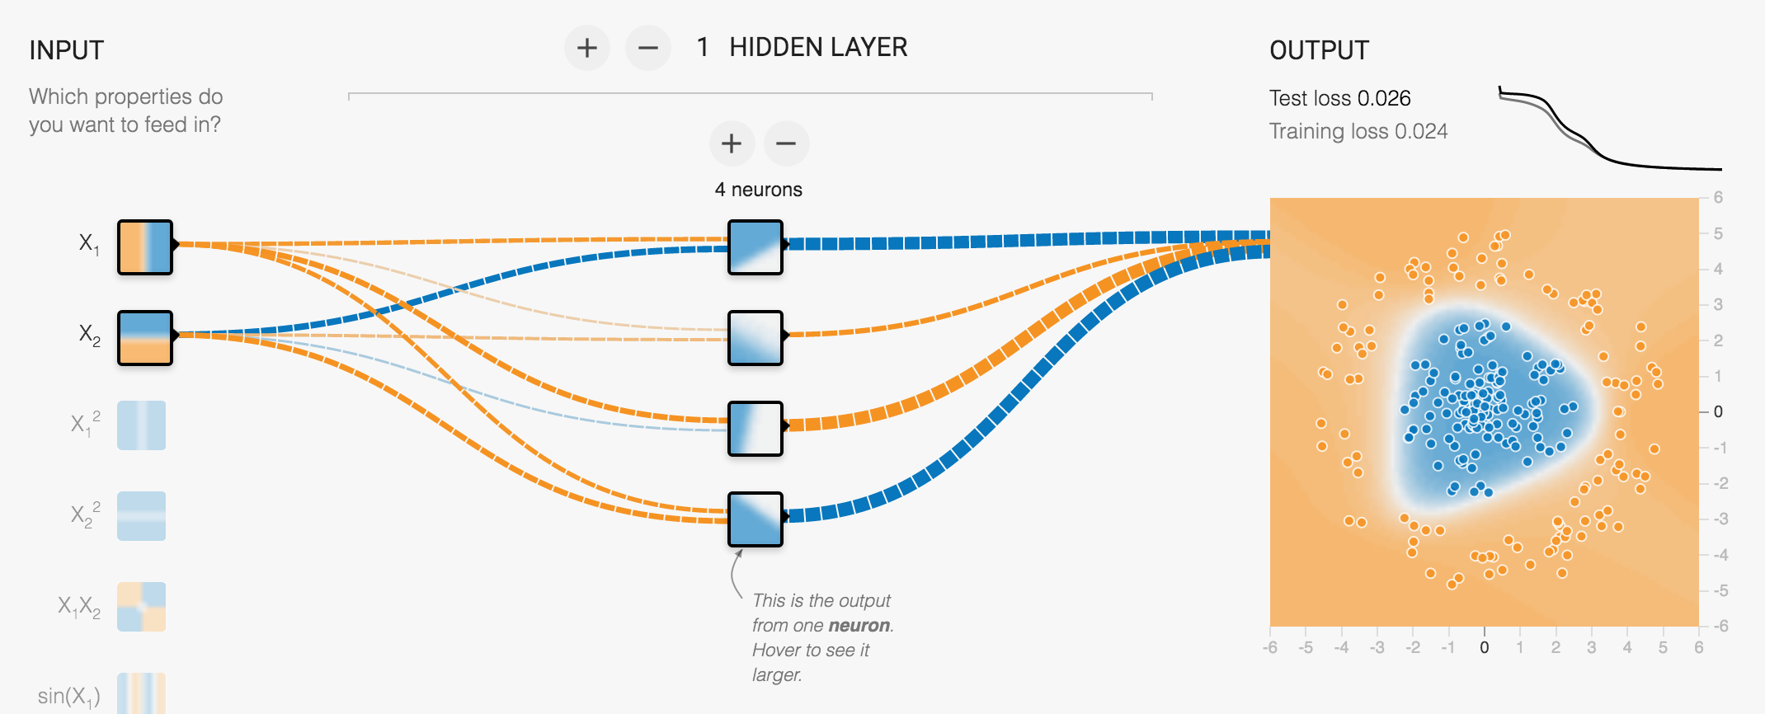
More neurons means more input combinations (features)
bit.ly/2W1R6VG
17
Notes:
Notes:
Note that the separation boundary is a polygon … each side is a linear combination of features …. We should have gotten a 4-sided polygon, but in the diagram above two of the sides merged (i.e., their weights were linearly correlated).
Playground URL for this pattern: https://goo.gl/SjQf5V

Slide 18
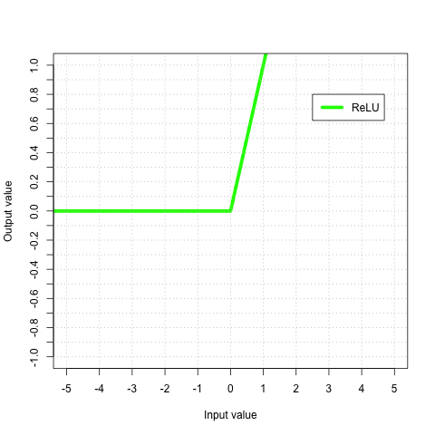
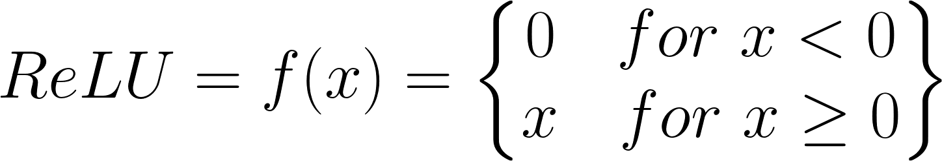
Rectified Linear Unit (ReLU): A common activation function
relu = max(0, x)
Python
nn.ReLU()
PyTorch

Slide 19
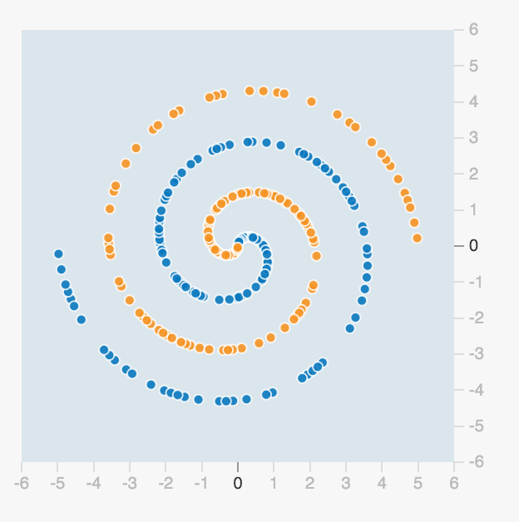
How about this? Will a set of lines work?
19

Slide 20
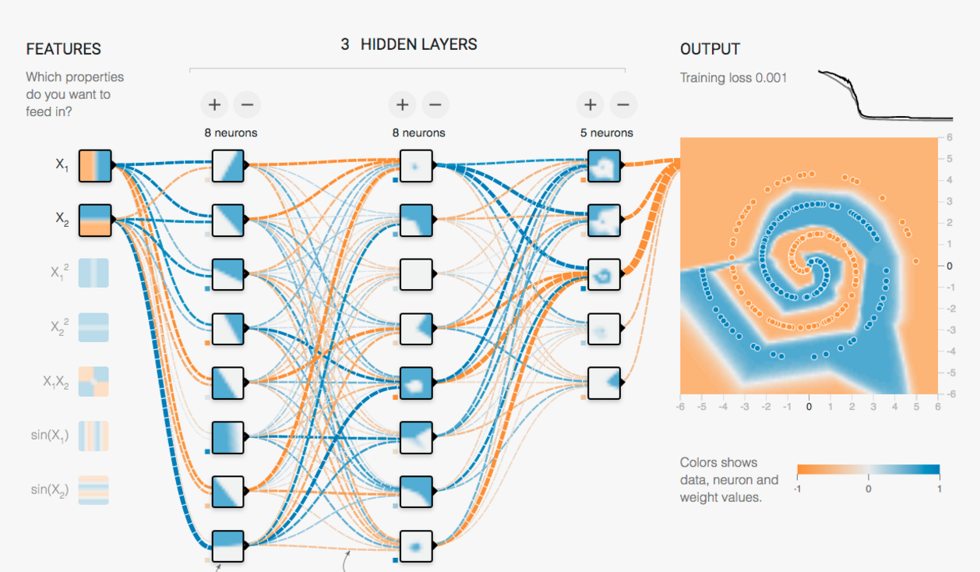
More hidden layers leads to more hierarchies of features
goo.gl/L6fj7F
20
Notes:
Notes:
Even a complex non-linear pattern such as the double spiral could be classified by the simple neural network.

Slide 21
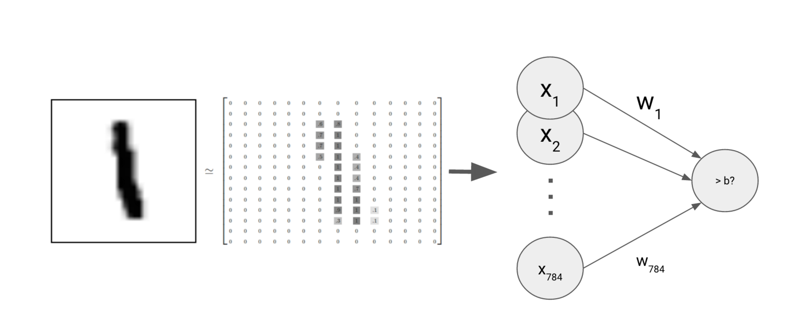
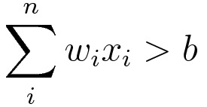
torch.nn is a PyTorch neural net layers library
Many-to-one, as well as fully-connected
many-to-many
Available Layers:
Linear
Convolution
Padding
Pooling
Normalization
Dropout
Recurrent
Embedding

Slide 22
nn.Linear() is a fully connected layer, every input to every output
Bias by default
from torch import nn
model = nn.Linear(#_inputs, #_outputs,
bias = True)
model.parameters()
model.weight, model.bias
model.zero_grad()
model.weight.grad, model.bias.grad
model(X)
Weights & bias
Zero out gradients
Access gradient values
forward()

Slide 23
torch.nn.Sequential helps organize neural nets with many layers
model = nn.Sequential(
nn.Linear(5, 5),
nn.ReLU(),
nn.Linear(5, 5),
nn.ReLU(),
nn.Linear(5, 5)
)
model(X)
forward pass

Slide 24
One-hot encoding an output node for each possible class
One: yes/no?
Two: yes/no?
Three: yes/no?
Four: yes/no?
Five: yes/no?
one-vs-all

Slide 25
Each pixel value is an input
28 x 28 grayscale image =
784 numbers
25

Slide 26
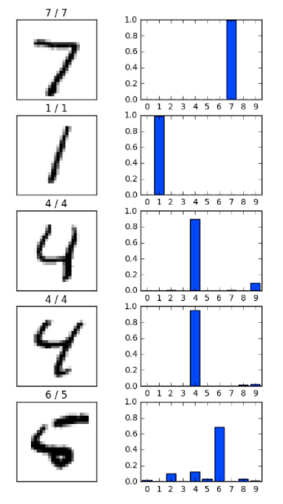
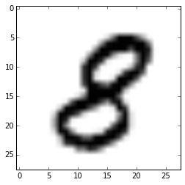
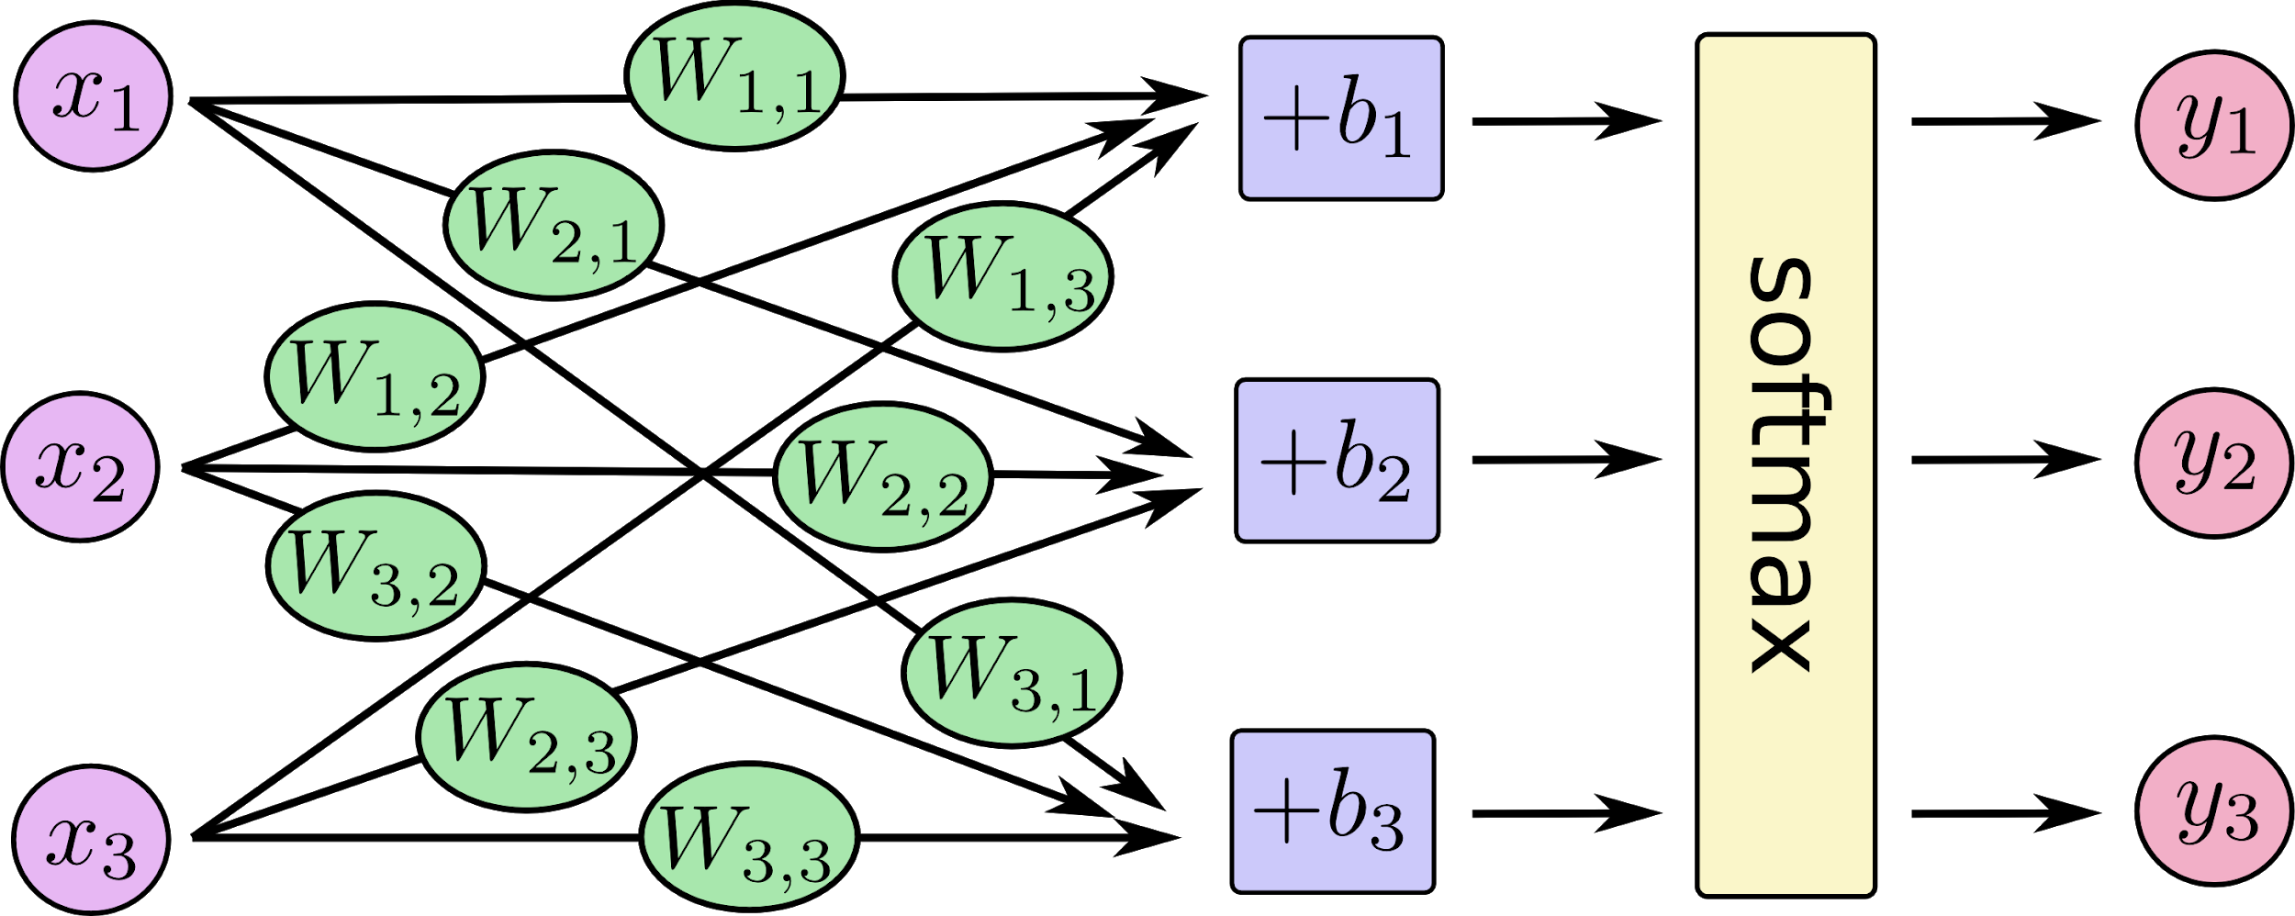
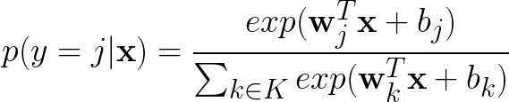
Softmax helps deal with non-binary (multivariate) target values
output vector (probability
estimate)
input vector
(pixel data)

Slide 27
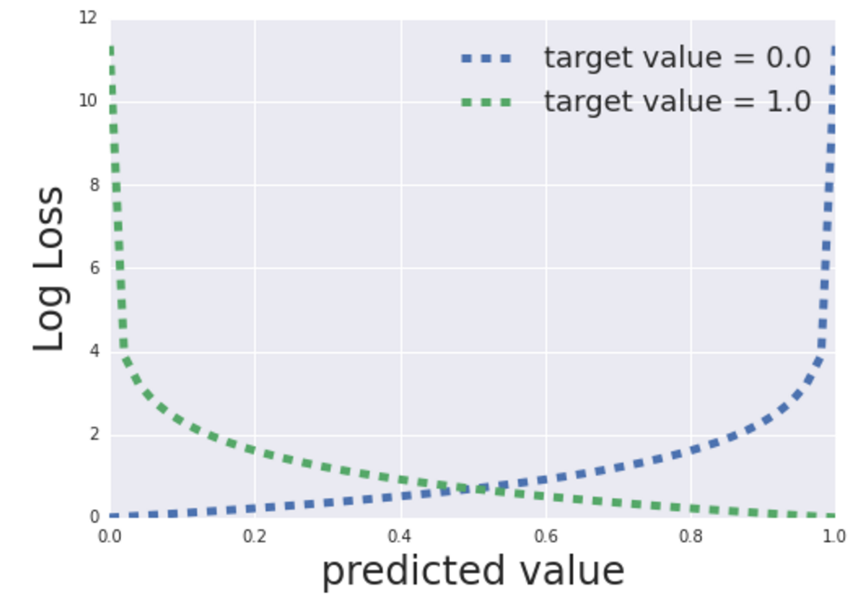
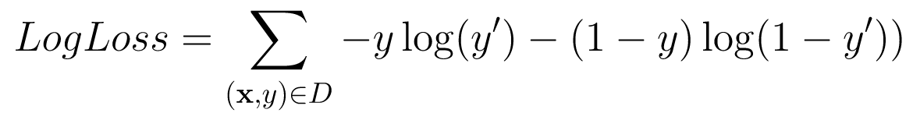
Negative log likelihood is the loss for softmax outputs
Notes:
Note that this has a convenient derivative with respect to w.
X-entropy also puts a lot less emphasis on errors where the output is relatively close to the label.
So that output=0.7 does not have 3x the error of output=0.9 (for label = 1)

Slide 28
torch.nn.functional.log_softmax() + nll_loss() = cross_entropy()
Softmax | Actual | Negative Log Likelihood
[.1, .9] | [0, 1] | -0*log(.1)-1*log(.9)=0.05
[.8, .2] | [0, 1] | -0*log(.8)-1*log(.2)=0.70
[.3, .7] | [1, 0] | -1*log(.3)-0*log(.7)=0.52
[.6, .4] | [1, 0] | -1*log(.6)-0*log(.4)=0.22

Slide 29
Demo: nn.Sequential Neural Net Classifier

Slide 30
Exercise: nn.Sequential Neural Net Classifier

Slide 31
Agenda
 | PyTorch Structured Dataset and DataLoader

Slide 33
PyTorch toolkit hierarchy
Run at scale
High-level “out-of-box” API
torch.lightning
Components useful when
building custom NN models
torch.utils.data, torch.nn, torch.optim
Python API gives you full control
Core PyTorch (Python)
Cloud Support: AWS, Azure, GCP
C++ API is quite low-level
Core PyTorch (C++ / ATen)
TF runs on different hardware
CPU
GPU
TPU
ARM
Notes:
Notes:
We’ll use the next lower level down in refactoring.

Slide 34
Explore a smaller sample of the training dataset then scale up
Iterate faster by developing your code on subsets of your training examples
Next, deploy your machine learning code to cloud and train with larger datasets
Full Dataset

Slide 35
To read sharded CSV files, use Pandas concat and then decode the CSV into features and targets for the training TensorDataset
from torch.utils.data import TensorDataset
df = pd.concat(
pd.read_csv(file) for file in Path('data/').glob('part-*.csv')
)
...
X = pt.tensor(train_df[FEATURES].values)
y = pt.tensor(train_df[TARGET].values)
train_ds = TensorDataset(y, X)
Notes:
Code for reading a CSV file
Directly supports a list of filenames if you have sharded files

Slide 36
TensorDataset is used to instantiate an enumerable DataLoader, which supports data batching and indexing
from torch.utils.data import DataLoader
train_ds = TensorDataset(y, X)
train_dl = DataLoader(train_ds, batch_size=BATCH_SIZE)
for epoch in range(EPOCHS):
for batch_idx, batch in enumerate(train_dl):
y, X = batch
Notes:
Code for reading a CSV file
Directly supports a list of filenames if you have sharded files

Slide 37

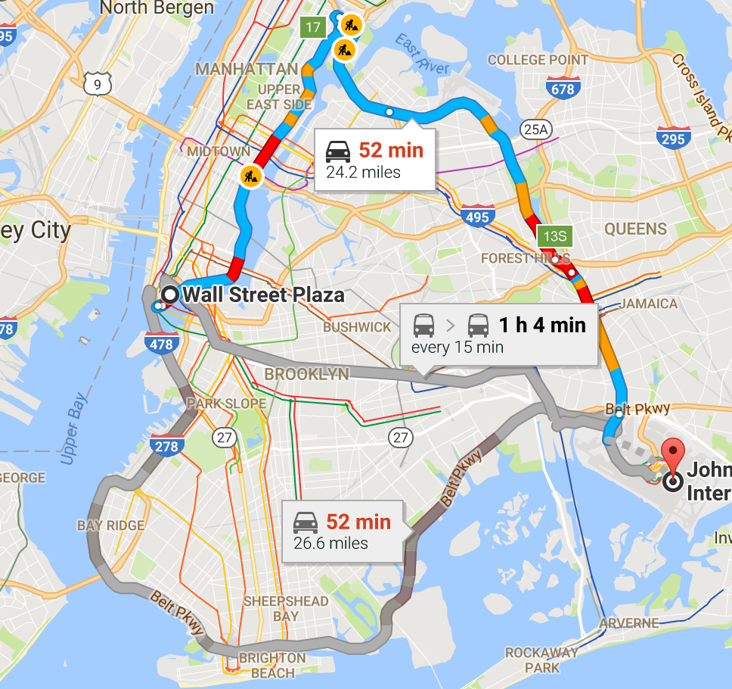
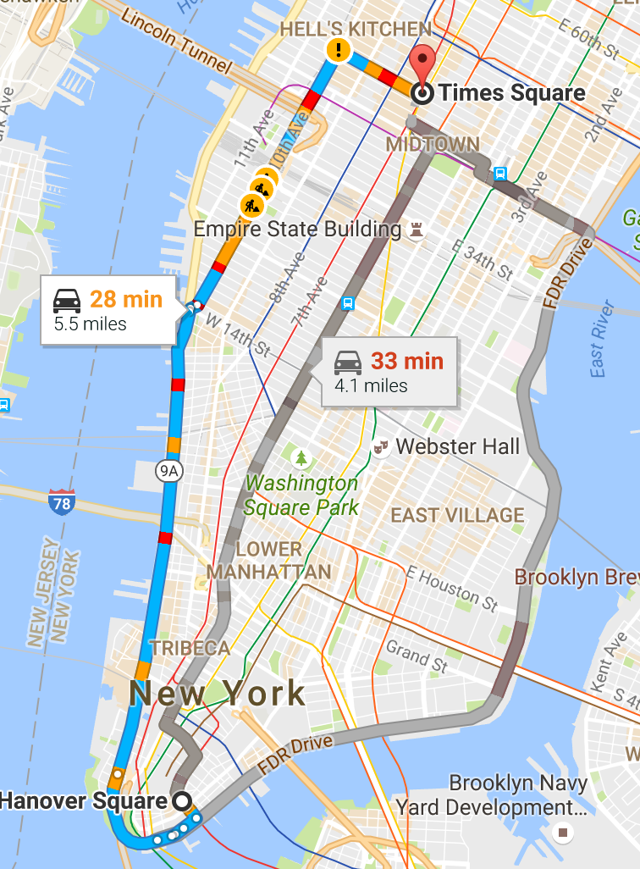
Objective: estimate NYC taxi fare
Taxi fares:
$2.50 initial charge
+
50c per ⅕ mile
(or)
50c per minute if stopped
+
Passenger pays tolls
+
Various special charges
http://www.nyc.gov/html/tlc/html/passenger/taxicab_rate.shtml
Notes:
(cc0) https://pixabay.com/en/question-mark-question-faq-ask-1421013/

Slide 38
The taxi fare data set includes details about each trip
Pickup Date/Time
Pickup and Dropoff Locations (in longitudes and latitudes)
Passenger Count
Trip Distance
Metered Fare
Tip Amount
Tolls Amount
Total Amount

Slide 39
Exercise: PyTorch Dataset and Dataloader

Slide 40
Agenda
 | Train and evaluate + Lab

Slide 41
Many machine learning courses focus on this…
ML CODE

Slide 42
…but what does it take to built a production ML system?
DATA
COLLECTION
DATA VERIFICATION
MACHINE
RESOURCE
MANAGEMENT
SERVING INFRASTRUCTURE
FEATURE EXTRACTION
ML CODE
ANALYSIS TOOLS
PROCESS MANAGEMENT TOOLS
CONFIGURATION
MONITORING
Hidden Technical Debt in Machine Learning Systems

Slide 43

We need to make our ML platform more robust
For realistic, real-world ML models, we need to:
1. Use a fault-tolerant training framework
2. Choose model based on a validation dataset
3. Monitor training, especially if it will take days
4. Resume training if necessary

Slide 44
PyTorch toolkit hierarchy
Run at scale
High-level “out-of-box” API
torch.lightning
Components useful when
building custom NN models
torch.utils.data, torch.nn, torch.optim
Python API gives you full control
Core PyTorch (Python)
Cloud Support: AWS, Azure, GCP
C++ API is quite low-level
Core PyTorch (C++ / ATen)
TF runs on different hardware
CPU
GPU
TPU
ARM
Notes:
Notes:
We’ll use the next lower level down in refactoring.

Slide 45
Getting started with PyTorch Lightning
Extend LightningModule
Forward (as usual)
class TaxiFareLinearRegressor(pl.LightningModule):
def forward(self, X): ...
def train_dataloader(self):
return self.train_dl
def configure_optimizers(self):
return pt.optim.AdamW(self.parameters())
def training_step(self, batch, batch_idx):
y_pred = forward(batch) ...
return {"loss": mse}
Return the DataLoader
Use module parameters to create the optimizer
Compute and return the loss (no backward)

Slide 46
PyTorch Lightning training loop
import pytorch_lightning as pl
from pytorch_lightning import Trainer
trainer = pl.Trainer()
trainer.fit(TaxiFareLinearRegressor())

Slide 47
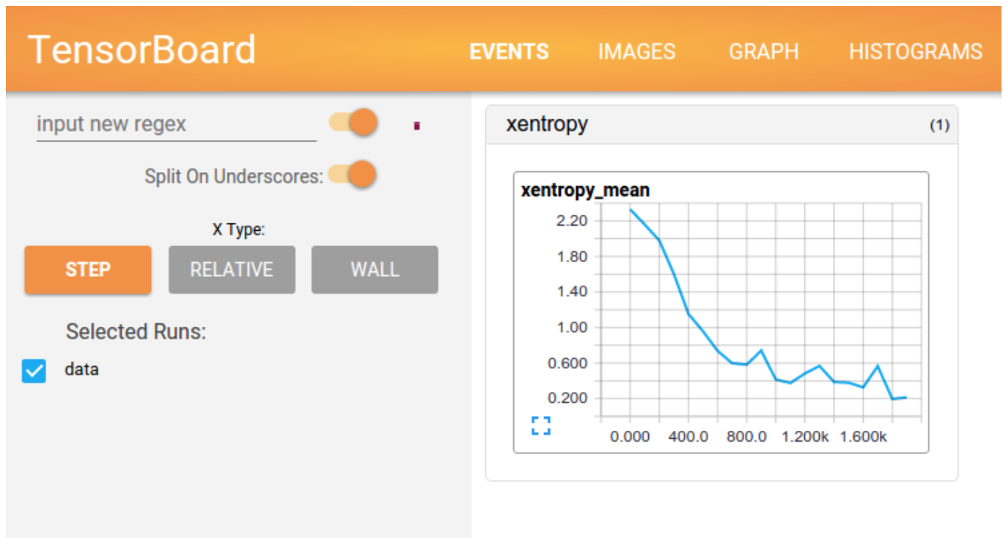
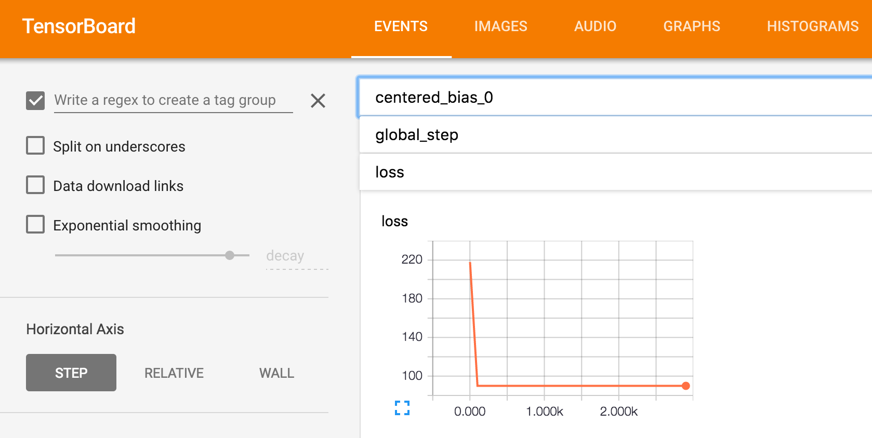
Use TensorBoard to monitor training
Loss
Metrics
%load_ext tensorboard
%tensorboard --logdir lightning_logs/

Slide 48
Demo: PyTorch Lightning

